Slide 1
Crisis Communications: Responding to the Media & the Public in Emergency Situations
Kim Biggs
Public Information Officer
Illinois Environmental Protection Agency

Slide 2
Crisis Communications: Responding to the Media & the Public in Emergency Situations
Have you ever struggled to know what to say and how much information to give out during an emergency?
Introduction
Emergencies
U.S. EPA Emergency Preparations
Examples from Past Trainings
  Risk Communication Program
  FEMA National Incident Management System Training
  Message Mapping
Resources and Contact Information

Slide 3
Types of Water Emergencies
Watermain breaks
Power outages, weather related or accidental
Failure of water storage tanks or other equipment
Treatment plant breakdowns
Supply chain/chemical shortages
Detection of water contaminants
Security Breaches
Weather Related Natural Disasters

Slide 4
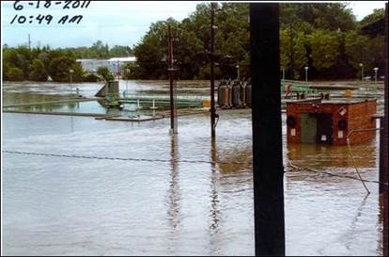
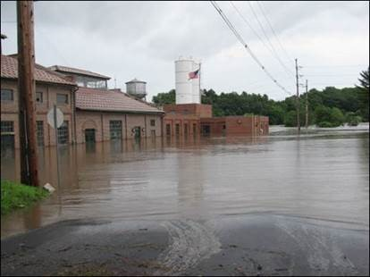
City of Jacksonville

Slide 5
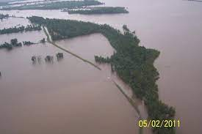
Alexander County Flooding
Photo Courtesy of Illinois Department of Natural Resources

Slide 6
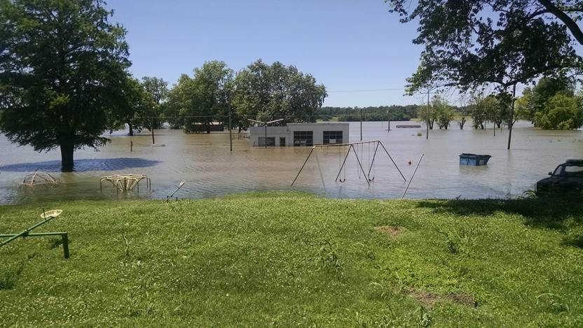
Thebes Flooding
Photo Courtesy of Illinois Department of Natural Resources

Slide 7
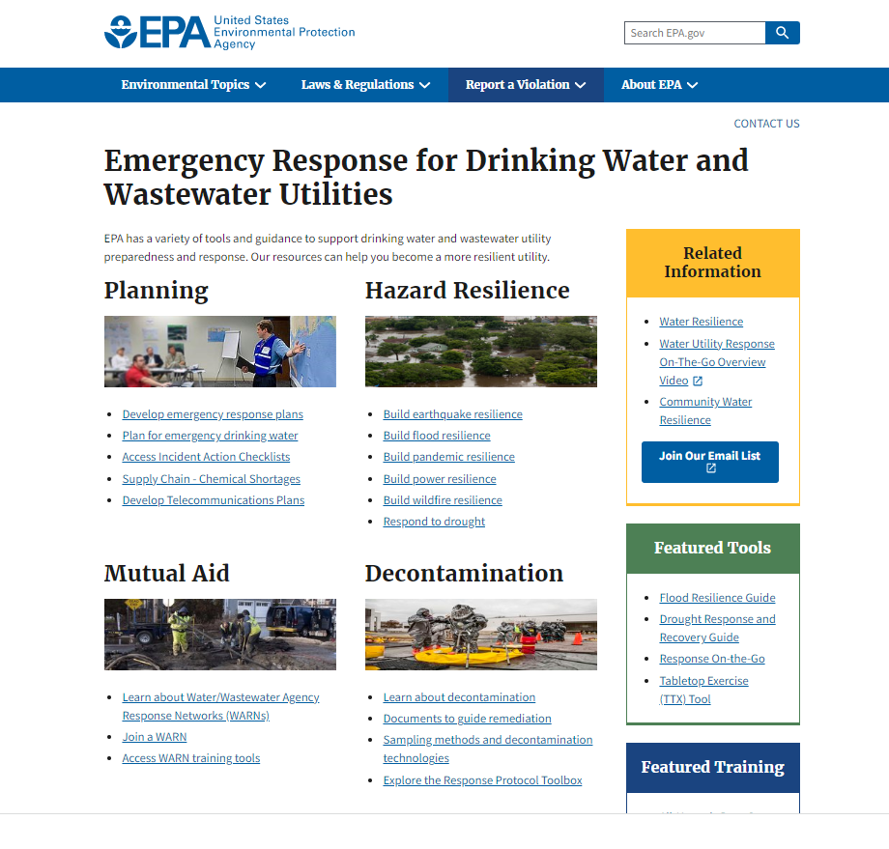
www.epa.gov/waterutilityresponse

Slide 8
Argonne National Laboratory:
Risk Communication Program
U.S. Army, FEMA, Chemical Stockpile Emergency Preparedness Program
Who is your audience?
What information do you need to get to them?
  Message Triangle
What information should NOT be provided?

Slide 9
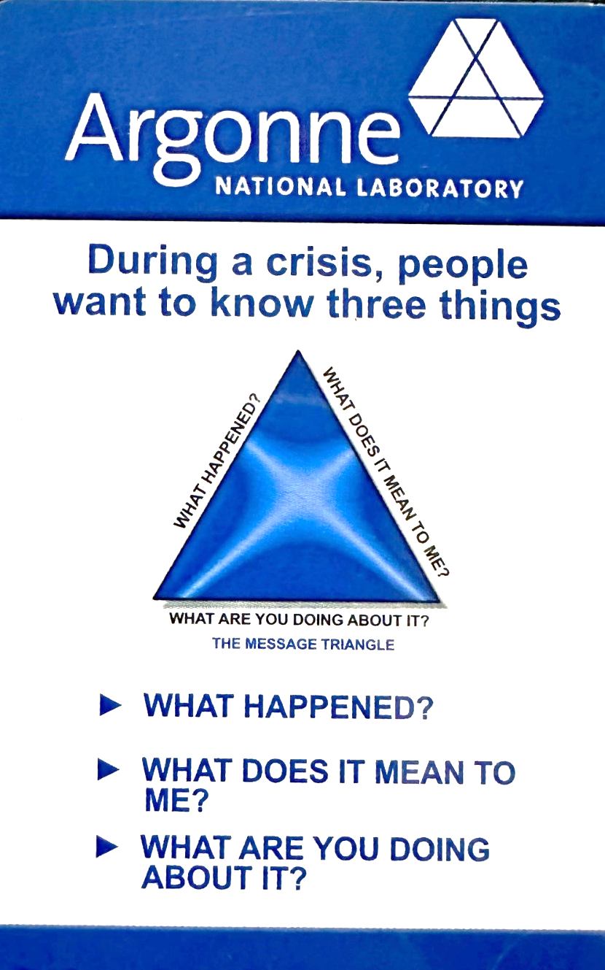

Slide 10
Argonne National Laboratory:
Risk Communication Program
Ten Commandments of Good Media Relations
        Be Honest
        Be Concise
        Be Available
        Be Timely
        Be Fair
        Be Flexible
        Be Objective
        Be Positive
        Be Informed
        Be Professional

Slide 11
Argonne National Laboratory:
Risk Communication Program
DO when talking to the Media
Take your time
Think before you answer
Say if you don’t know
Stick to the facts
Say if you can’t answer – explain why
Talk only about your area of expertise
Assume everything is “on the record” and is being recorded
Maintain eye contact with the reporter
Be firm, fair, and honest

Slide 12
Argonne National Laboratory:
Risk Communication Program
DO NOT when talking to the Media
Lie, guess, or speculate
Get upset or angry
Use acronyms or jargon
Talk about protected information
Talk about information outside of your area of expertise
Repeat negative words from questions
Play favorites with reporters
Say “no comment”
Introduce new issues or subjects

Slide 13
FEMA National Incident Management System (NIMS) Training
Who is affected?
What is happening?
When did this or will this happen?
Where is it occurring?
Why should people care?

Slide 14
FEMA National Incident Management System (NIMS) Training
Helpful Tips:
Express empathy
Be helpful
Use plain language
Avoid clichés
Promote action
Show respect
Promote collaboration

Slide 15
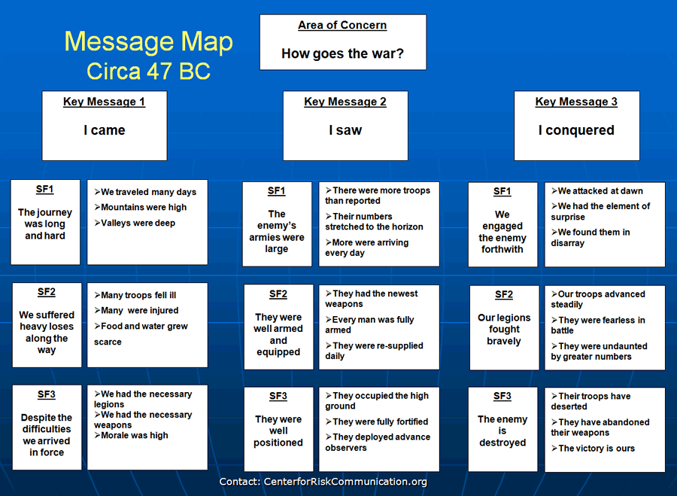
Center for Risk Communication
Dr. Vincent Covello

Slide 17
Center for Risk Communication
Message Mapping
Seven Steps:
Identify your stakeholders
Identify specific concerns of those stakeholders
Identify common general concerns
Develop key messages
Develop Supporting facts for each key message
Testing your messages
Plan to deliver your messages

Slide 18
Center for Risk Communication
Dr. Vincent Covello
“Message Mapping Template or Example”

Slide 19
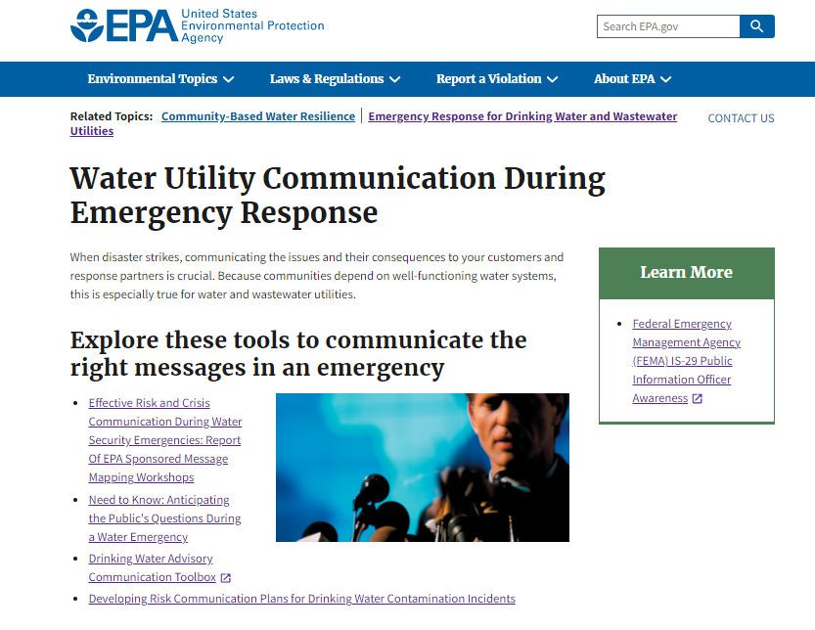
www.epa.gov/waterutilityresponse

Slide 20

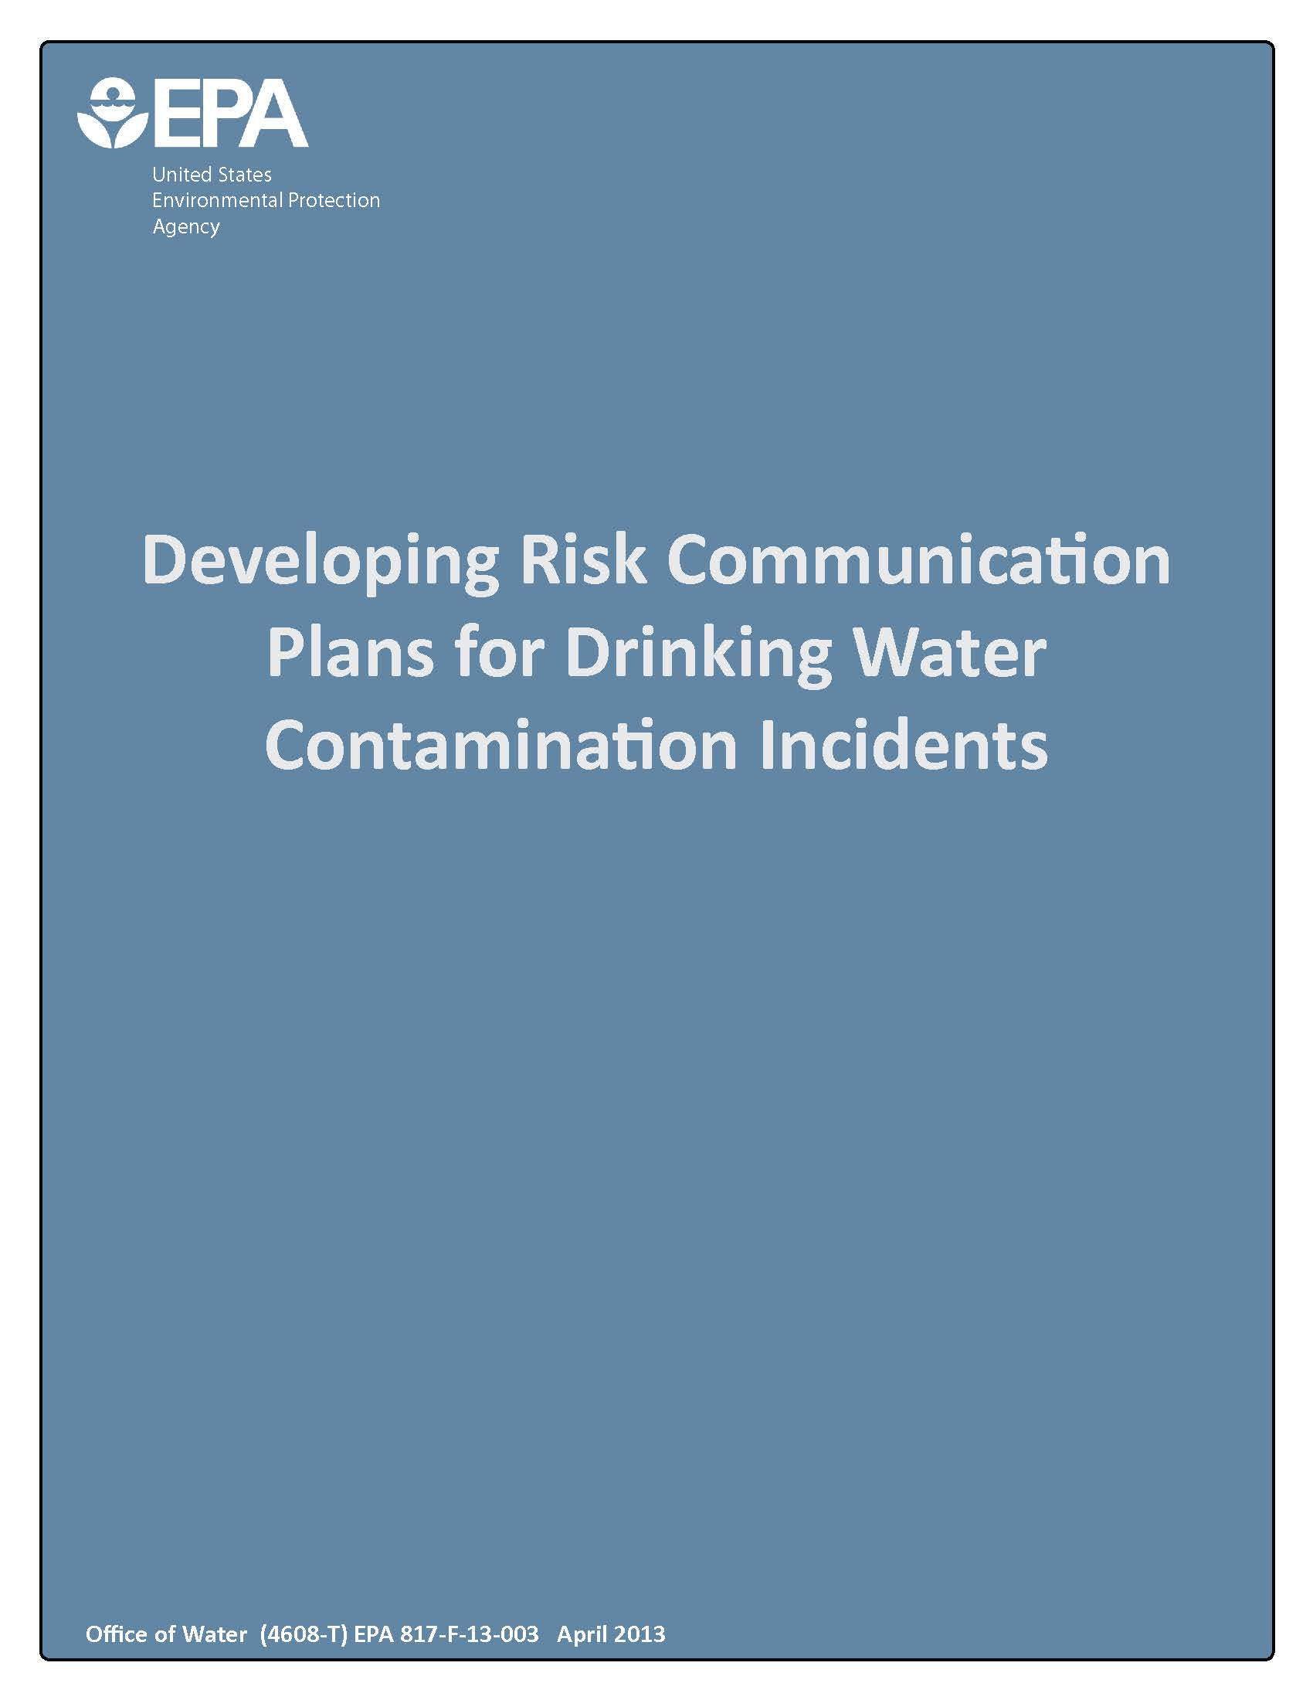


Slide 21
Illinois EPA Field Offices
2125 South First Street Champaign, IL 61820 (217) 278-5800 | 1101 Eastport Plaza Drive Suite 100 Collinsville, IL 62234 (618) 346-5120
9511 W. Harrison Street Des Plaines, IL 60016 (847) 294-4000 | 595 South State Elgin, IL 60123 (847) 608-3131
2309 W. Main Street Marion, IL 62959 (618) 993-7200 | 412 SW Washington Street Suite D Peoria , IL 61602 (309) 671-3022
4302 North Main Street Rockford, IL 61103 (815) 987-7760 | HEADQUARTERS: 1021 North Grand Avenue East Springfield, IL 62702 (217) 782-3397

Slide 22
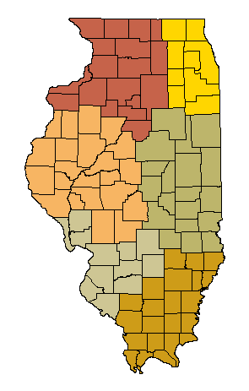
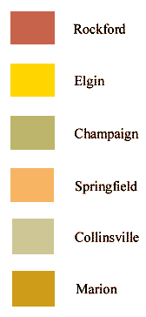
Illinois EPA Public Water Supply Offices

Slide 23
Illinois EPA Public Water Supply Office Contacts
Rockford (815) 987-7760
Division of Public Water Supply
Regional Manager: Segundo Nallatan
Staff: Andrew Holloway and Fei Zhao
Groundwater Staff: Greg White
Elgin (847) 608-3131
Division of Public Water Supply
Regional Manager: Segundo Nallata
Staff: Grover Hopkins, Dharmishtha Patel, Dwayne Booker, and Gopi Ramanathan
Champaign (217) 278-5800
Fax: 217-278-5808
Division of Public Water Supply
Staff: Matt Talbert and Shane McCulley
Springfield 217-557-8761
Division of Public Water Supply
Staff: John Bartolomucci, Mike Dragovich, and Jamie Cowles
Collinsville (618) 346-5120
Fax: 618-346-5155
Division of Public Water Supply
Regional Manager: Gayle Renth
Staff: Regan Taylor and James Blessman
Marion (618) 993-7200
Fax: 618-997-1281
Division of Public Water Supply
Regional Manager: Gayle Renth
Staff: Chris Johnston and John Kinder

Slide 24
Illinois EPA Communications Contact
Kim Biggs
Public Information Officer
Illinois EPA
(217) 558-1536
Kim.Biggs@illinois.gov

Slide 25
Illinois EPA Tips for Speaking with the Public, Media, and other Officials
Use plain language
Be concise
Repeat your most important points
Listen.
DO NOT speak to issues you cannot address
DO NOT speculate on hypothetical situations
Think through how you will communicate certain ideas

Slide 26
Illinois EPA Tips for Speaking Continued
In public settings, remember your body language
  DO NOT stand or sit with crossed arms
  Make eye contact
  Respect personal space
Remain calm
  DO NOT become argumentative
  Use a level tone of voice
  Avoid using highly charged words
Use an active voice to make points clear (e.g. – The system is responsible for …)

Slide 27
Thank You.

